Slide 1

Fleet Action Center, Phase I Research
Leslie A. McFarlin
2 September - 5 October 2021

Slide 2
Executive Summary
Fleet Action Center presents an opportunity to shift to a proactive style of fleet management from the current reactive style exhibited in this research.
Proactive work styles emerge in work environments that provide employees the cognitive space, tools, and data to engage in strategic thinking.
Currently, AEs operate in a work environment marked by:
Fluctuating workload size, both daily and seasonally.
Bespoke processes for clients.
Various, and sometimes unpredictable, disruptions.
Useful but unintegrated information within a mix of older and newer tools of differing levels of usability.
Circular, and sometimes frustrating, interactions with other client teams (Registration, VIM).
AEs also indicated that their work spills over into personal time, with some people working in the evenings, and others working on the weekends to avoid falling behind.

Slide 3
Executive Summary
Many aspects in an AEs work environment cannot be controlled directly by them, so they use specific strategies to control the flow of information around them and adjust to changes in their environment.
Client-centric inbox organization.
Limiting channels of communication available for non-clients.
Set timeframes for reviewing particular types of information.
Daily routines for performing types of tasks.
Monitoring personal and team metrics via dashboards.
Most factors contributing to an AE's high cognitive workload can be reduced by improvements to tools and processes.
Some things, such as workload, vary according to clients, client load, and time of year.
Tools suffer from 3 main issues:
Lack of information collocation.
Performance.
Inconsistent interactions.

Slide 4
Executive Summary
Processes suffer from a wide variety of issues:
Unclear and unmet expectations for communications between teams and to clients.
Back-and-forth between AEs and other teams for activities (example: Registration).
Repetitiveness of manual activities.
Wheels is already taking steps to address tool-specific issues, and that good work should be continued.
AEs indicated the changes to Ordering have already been a big help for easing their workflow issues.
Consolidate UIs with related information into one location, such as FleetView, to increase efficiency.
Continue updating older sections of FleetView and addressing usability issues as they are identified.
Technology solutions can assist with some process issues, such as repetition and back-and-forth between teams.
RPA + intelligent content systems are common solutions for these problems.

Slide 5
Executive Summary
Unresolved communication issues have resulted in other teams leaving all client communications up to AEs.
This increases the AE workload, as pointed out by multiple participants.
In one observed instance, a VIM associate completely stopped responding to an AE's requests for updates, leaving the case in limbo.
Observed communication issues require clear boundaries and guidelines that are then documented and communicated across all teams.
If other teams will be allowed to directly contact clients, ensure they have call scripts to reference.

Slide 6
Next Steps
Client research on preferred interaction styles with Wheels fleet associates.
Assess preferred levels of interactivity with a fleet associate.
Determine if some topics require personal interactions versus impersonal ones, such as email.
Understand views on self-service.
Exploring the Registration workflow across teams.
Understand the current process and identify how it can be improved.
Translate findings into a prototype workflow that can then be evaluated by associates.
Perception of roles and responsibilities [Set up another meeting for this.]
Top interactions [how are things introduced during training; need to connect process and scenarios; need to train on exceptions which is not currently done; dots aren't connected on multiple reports; reports don't give what clients want/need]
Accountability, who does what, change control procedure
Differing procedures for areas.
Optional: Baselining cognitive workload across the AE team.
Determining current levels of cognitive workload and how they may vary across level (AAE vs Senior AE).
Track effectiveness of changes in reducing cognitive workload.

Slide 7

Study Summary
Research Topic: Client Services Processes
What tasks, tools, and knowledge are required for AEs and their leaders on a daily basis?
Which tasks are most common versus least common?
What goals are users trying to achieve?
How do other client-focused teams interact with AEs?
What are AEs’ perceptions of their environment, tools, and tasks?
How do AEs feel about their environment, tools, and tasks?
Method: Contextual Task Analysis (Contextual Inquiry)
Project Code & Repository: FAC-001
Research tools: Powerpoint Assistant

Slide 8
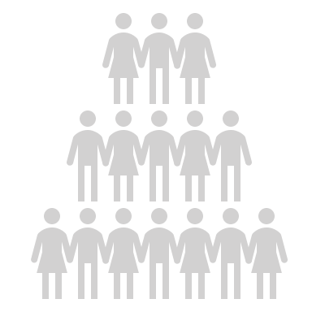
Participants and Methodology

Slide 9

Participants (6)
Name | Role – Activity
{ Name Removed } | Manager, Client Services – Manager Interview
{ Name Removed } | Account Executive – Contextual Inquiry (Task Analysis)
{ Name Removed } | Account Executive II – Contextual Inquiry (Task Analysis)
{ Name Removed } | Account Executive – Contextual Inquiry (Task Analysis)
{ Name Removed } | Account Executive II – Contextual Inquiry (Task Analysis)
{ Name Removed } | Account Executive – Contextual Inquiry (Task Analysis)

Slide 10

Methodology
Contextual Inquiry (a.k.a., Contextual Task Analysis)
Combination of in-depth observations and interviews.
Used to gain a deep understanding of work practices and behaviors.
Requires a small sample of users, but sessions can take 2 or more hours per user.
Context
Partnership
Interpretation
Focus
Observe participants in real-time.
Question them about their actions and thoughts.
Participants are the subject matter expert.
Researchers partner with the SME to learn about their domain and practices.
Researchers interpret meaning.
Meaning leads to understanding design implications.
Research shifts focus as the SME shifts their focus (such as between tasks).

Slide 11

Study Tasks
Interview
Describe participant backgrounds.
Understand what a typical workday looks like.
Identify most common and least common tasks.
Identify the Wheels apps and externally-created tools participants rely on to perform tasks.
Understand perceptions and attitudes towards the tools participants use.
Observation
Observe the steps participants take to complete their tasks.
Elicit specific input on the efficiency of tasks and tools.
Discuss the flow of information between AEs and other client-focused teams.

Slide 12

Findings

Slide 13
A Day in the Life of an AE…
AEs begin their days in one of two ways:
Meetings.
Checking email or SalesForce for new cases/case updates.
No two days are ever the same, and workload fluctuates with the time of year.
AEs are available for calls 4.75 hrs of the day at least.
Some AEs stay available up to 6 hrs a day in order to serve their clients better.
Some AEs forego lunchbreaks or other short breaks because they have so much to do.
Workdays do not end once a scheduled workday ends.
All AEs indicated working in the evenings.
Two AEs indicated working on the weekends to keep from falling behind.

Slide 14
Findings: Multi-Tasking and Interruptions

Slide 15
Findings Summary
AEs must often multi-task in order to perform their roles, with multi-tasking being sequential (rapid succession of tasks) or concurrent (2 or more things at once).
AEs face a variety of interruptions when performing tasks that impacts their work performance, the sources of which can be thought of as external or internal.
Interruptions also occur sequentially or concurrently with tasks and can also impact work performance.
External | Internal
Intrusion- important task unrelated to current task focus that forces a shift in attention. | Break- disengagement from a task intended to have a positive benefit on mental and emotional resources.
Distraction- environmental background stimuli that harms the ability to focus on a task. | Rumination- internal focus on features of difficult situations, causes, and consequences.

Slide 16
Findings Summary
Observed multi-tasking activities by type:
Concurrent activities for AEs are most commonly pairings of passive and active activities.
Passive example: Listening
Active example: Typing, switching screens
Sequential activities also mixed passive and active activities, but the sequence of activities in the chain varied according to the needs of the case.
Sequential | Concurrent
Swapping between applications (Chrome to FleetView) | Listening (to callers) while creating/completing cases.
Pointing out issues to observer | Listening (to observer) while working on cases.
Swapping between cases (based on external prompt)
**Note: Some observed multi-tasking were unique to the session and would not normally be present in the environment. Specifically, any interactions directed to observer.

Slide 17
Findings Summary
Observed disruptions by type:
External |  | Internal
Intrusion | Distraction | Break | Rumination
Teams messages | People in the work area | Ending sessions | Dwelling on other cases
Emails | Pets
Phone calls | Noises outside
Questions from observer
**Note: Some observed disruptions were unique to the session and would not normally be present in the environment. Specifically, ‘Questions from observer’ and ‘Ending sessions.’

Slide 18
AE Experience Interruption via Multiple Channels
Three main channels of interruptions were identified during observation: Email, Teams, and telephone.
Email seemed the least disruptive channel, as it fed directly into SalesForce or messages landed in client-specific folders.
Emails appearing in SalesForce and Outlook seems counterproductive to one AE.
Teams and telephone communication often diverted AE’s attention from their current tasks to other tasks.
Assisting with a different request from a client or another AE.
Creating a new request.
In some observed instances, AEs audibly indicated being disoriented from their original task.

Slide 19

Phone Intrusion Example [Length: 21s]
Scenario: AE is writing an email to a client regarding a vehicle for use by an intern when they receive an incoming call.
Issue: The interruption is abrupt. The phone queue screen completely takes over, forcing an end to the previous task in a potentially disorienting manner.
Note: As the screens switch from email to the call management application, there is a black flicker as if the screen were switching off. That is likely due to the screensharing during the session and would not be common during a regular workday.

Slide 20
Findings: Cognitive Workload

Slide 21
Findings Summary
AEs experience varying levels of cognitive workload everyday.
Cognitive workload describes the level of mental resources required during task performance.
Affects the ability to process information, which then affects decision making and reactions to situations.
Influenced by size of assigned workloads, tools, processes.
Working on cases requires leveraging multiple sets of knowledge simultaneously:
Client knowledge: Client personalities, services, fleet needs or issues
Process knowledge: SLAs, unique processes, what information is needed, where information lives, where information needs to go
Tool knowledge: Steps to access information, steps to transfer information
Most of the factors affecting cognitive workload levels cannot be controlled by AEs.
Assigned workload size is an uncontrollable factor and causes AEs to work outside of normal work hours.
Wheels can control some aspects of tools and processes.

Slide 22
Findings Summary
AEs employ a variety of strategies to manage factors contributing to cognitive workload.
Client-centric inbox organization.
Limiting channels of communication available for non-clients.
Set timeframes for reviewing particular types of information.
Daily routines for performing types of tasks.
Monitoring personal and team metrics via dashboards.
Managing cognitive workload slows how quickly AEs becomes overloaded:
Controlling the flow of external information they receive.
Tracking their performance to know how to adjust their behaviors.
Creating effective habits to reduce uncertainty in the environment.
High levels of cognitive workload also influence types of behavior, resulting in more reactive behaviors than proactive ones.
Reactive behaviors do not require advance planning, they happen based on readily available information.
Proactive behaviors emerge when people can process information and create strategies.

Slide 23
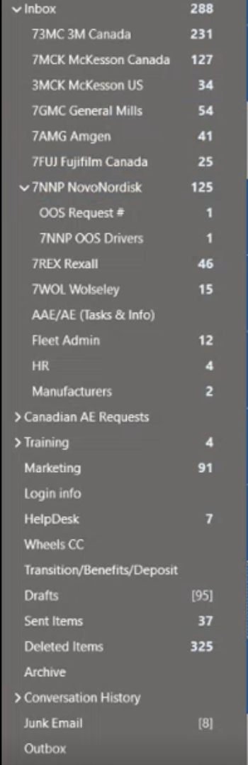
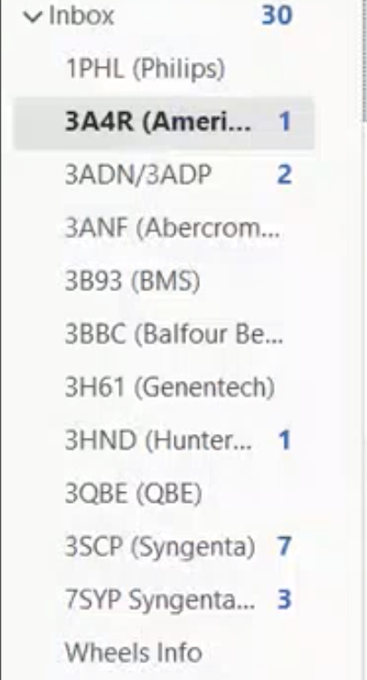
Examples of Inbox Organization
“So in my emails I have different folders in there to be organized from different clients and then how I kind of go about my day is which client gives me more leeway? It sounds pretty bad right? But each client has different…level of responsiveness for me.”

Slide 24
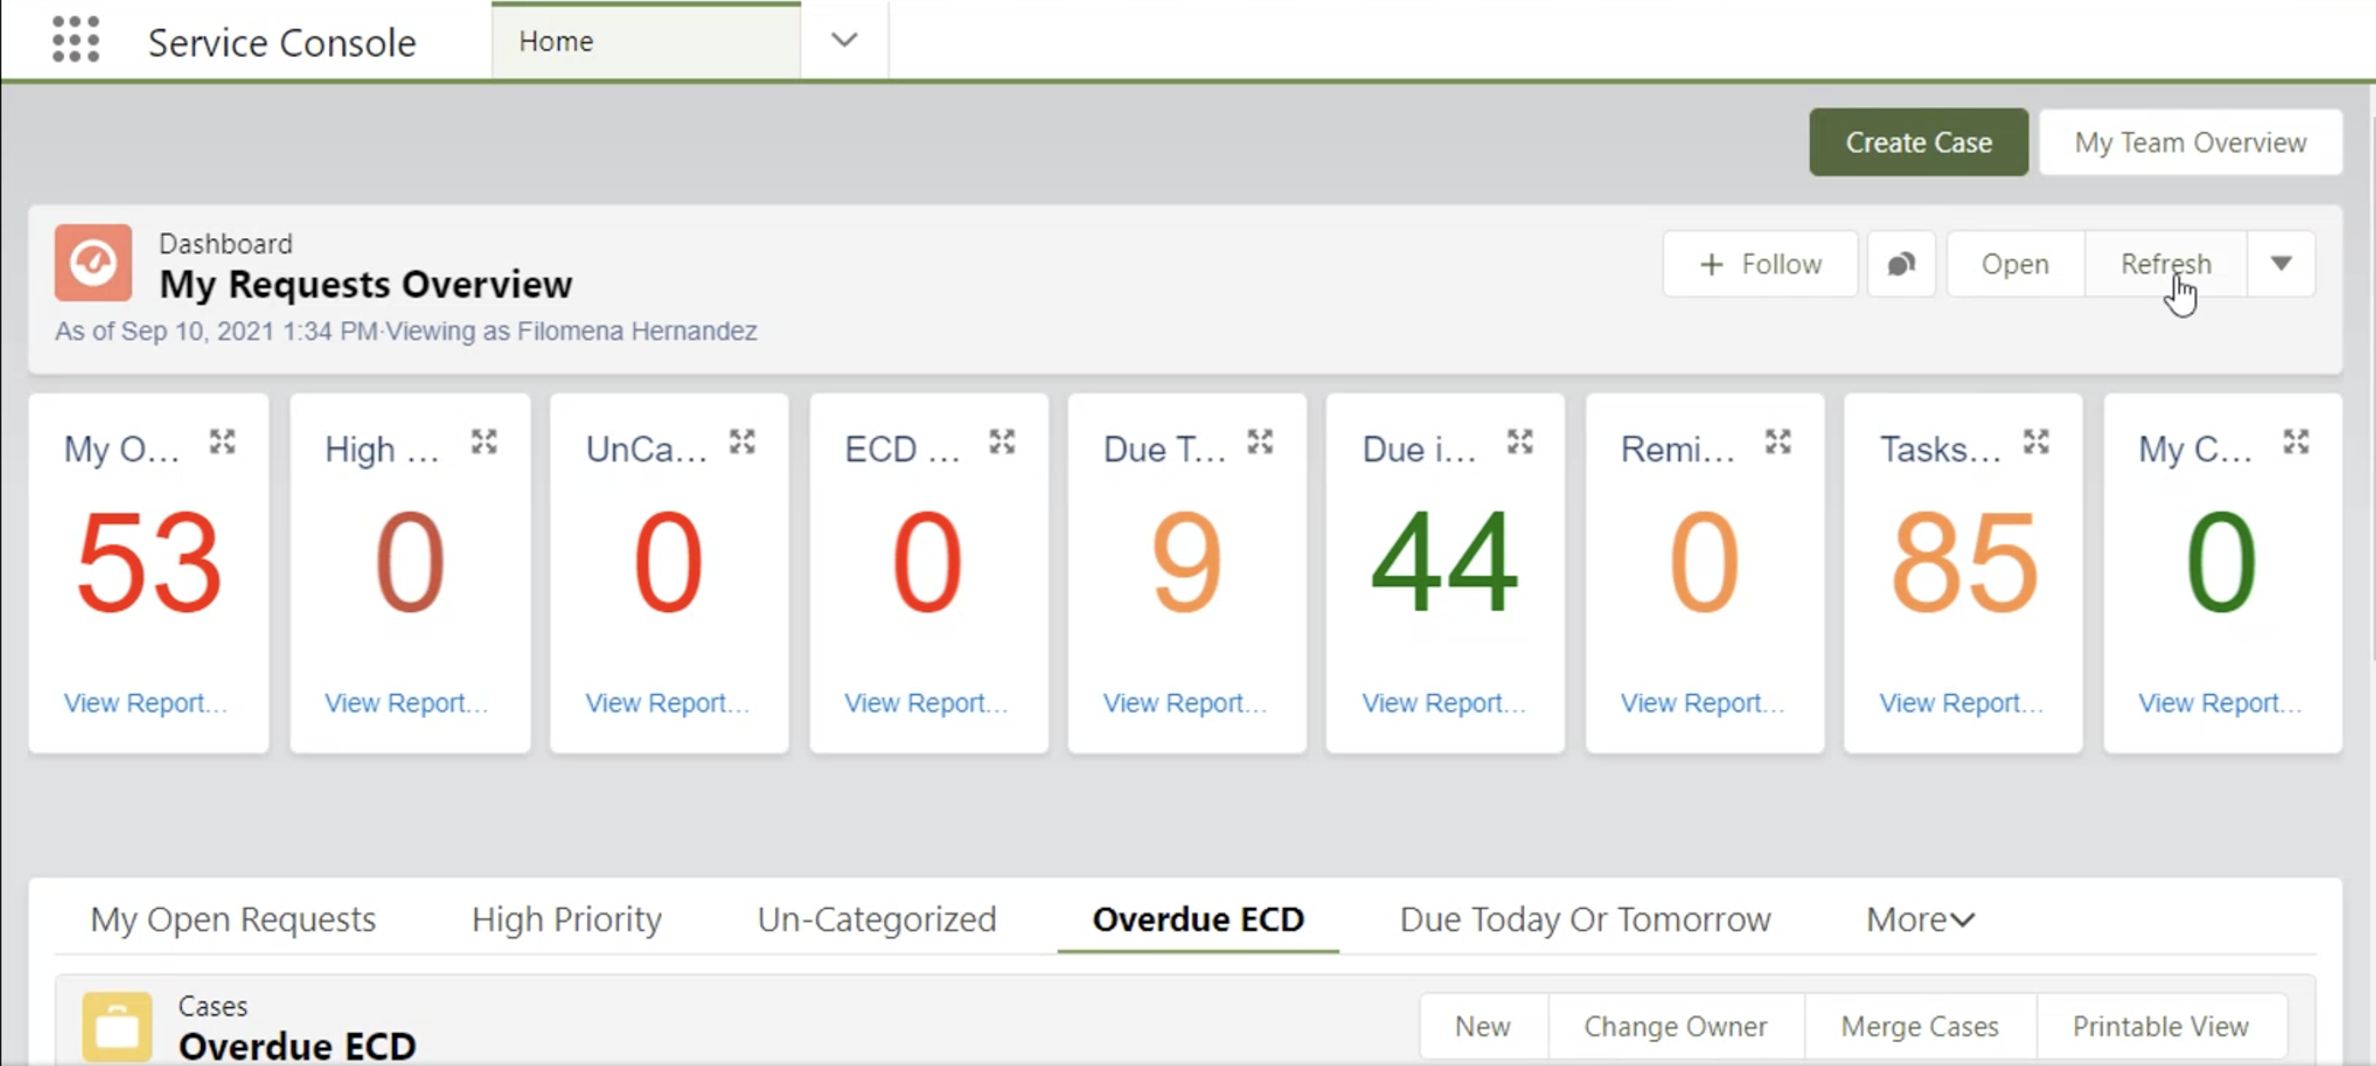
Personal Dashboard Example

Slide 25
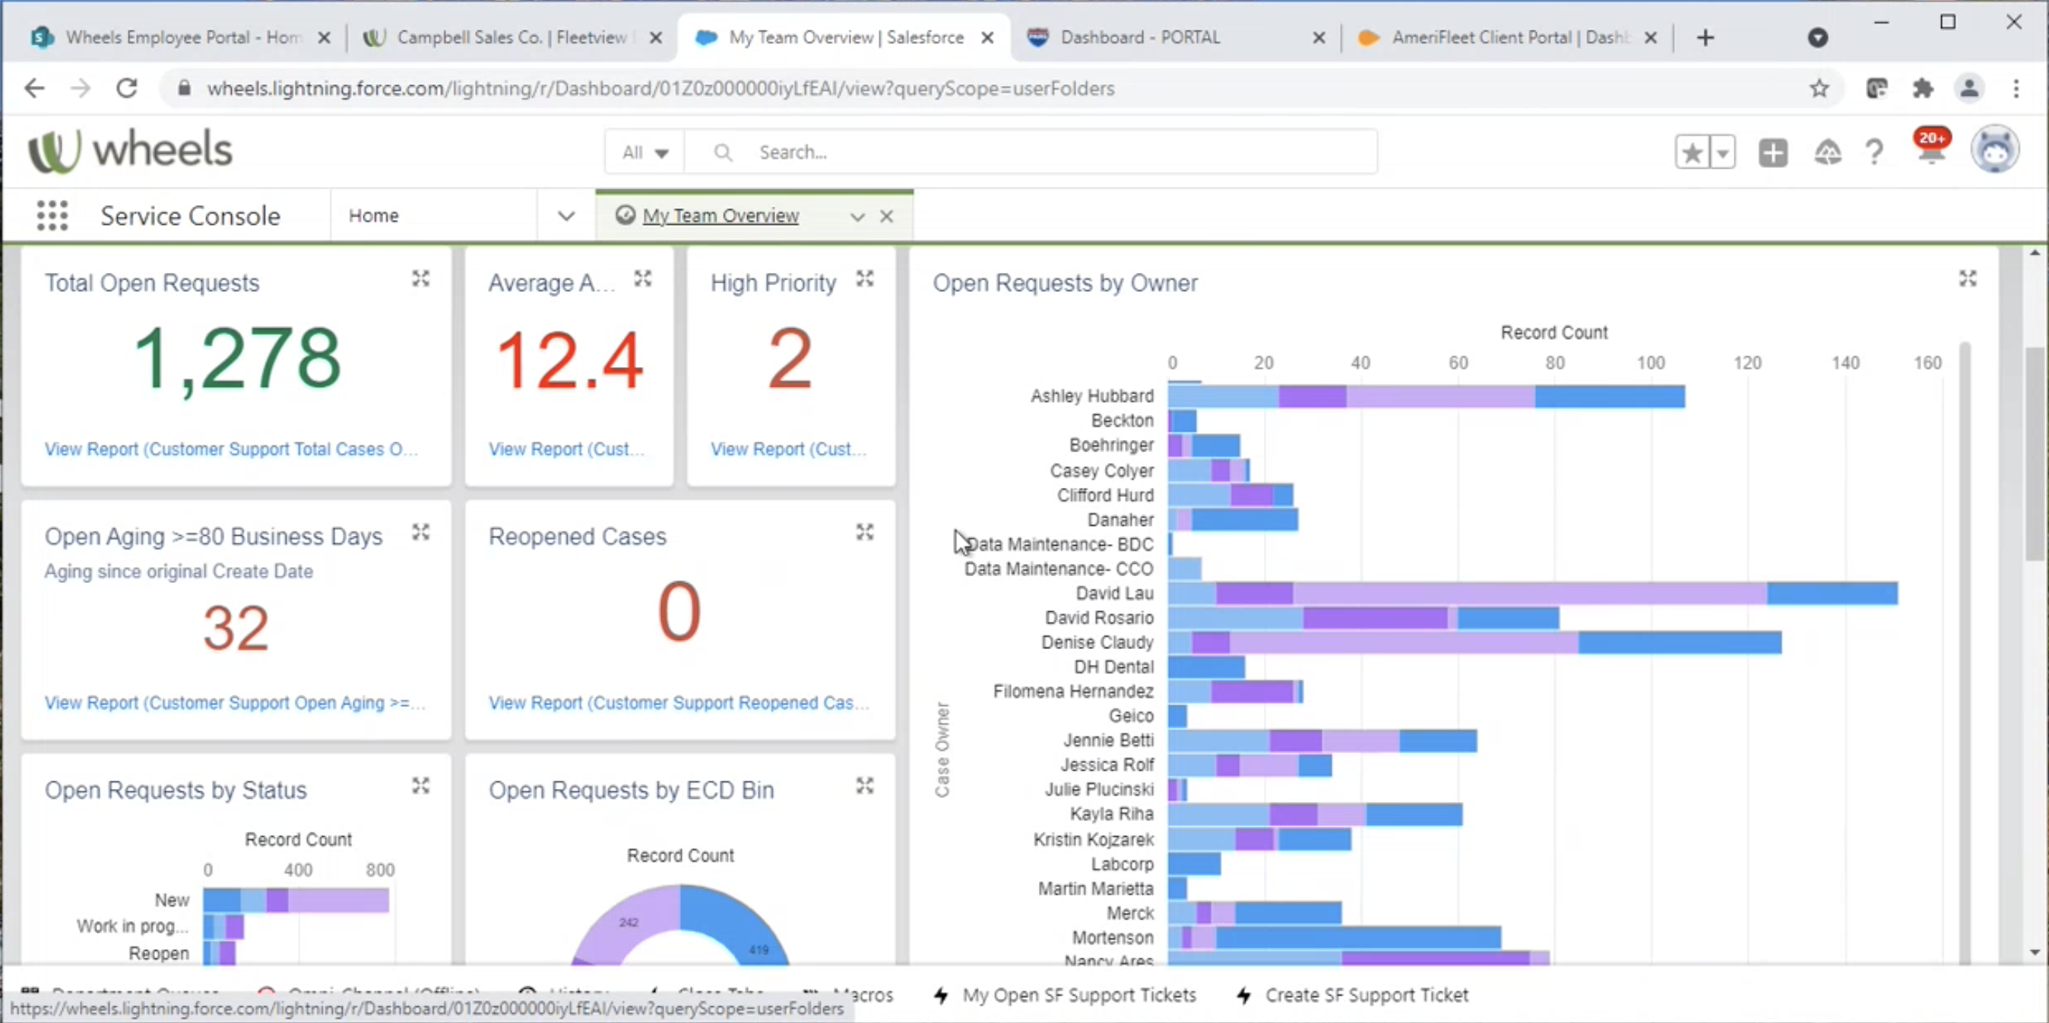
Example of My Team Overview I

Slide 26
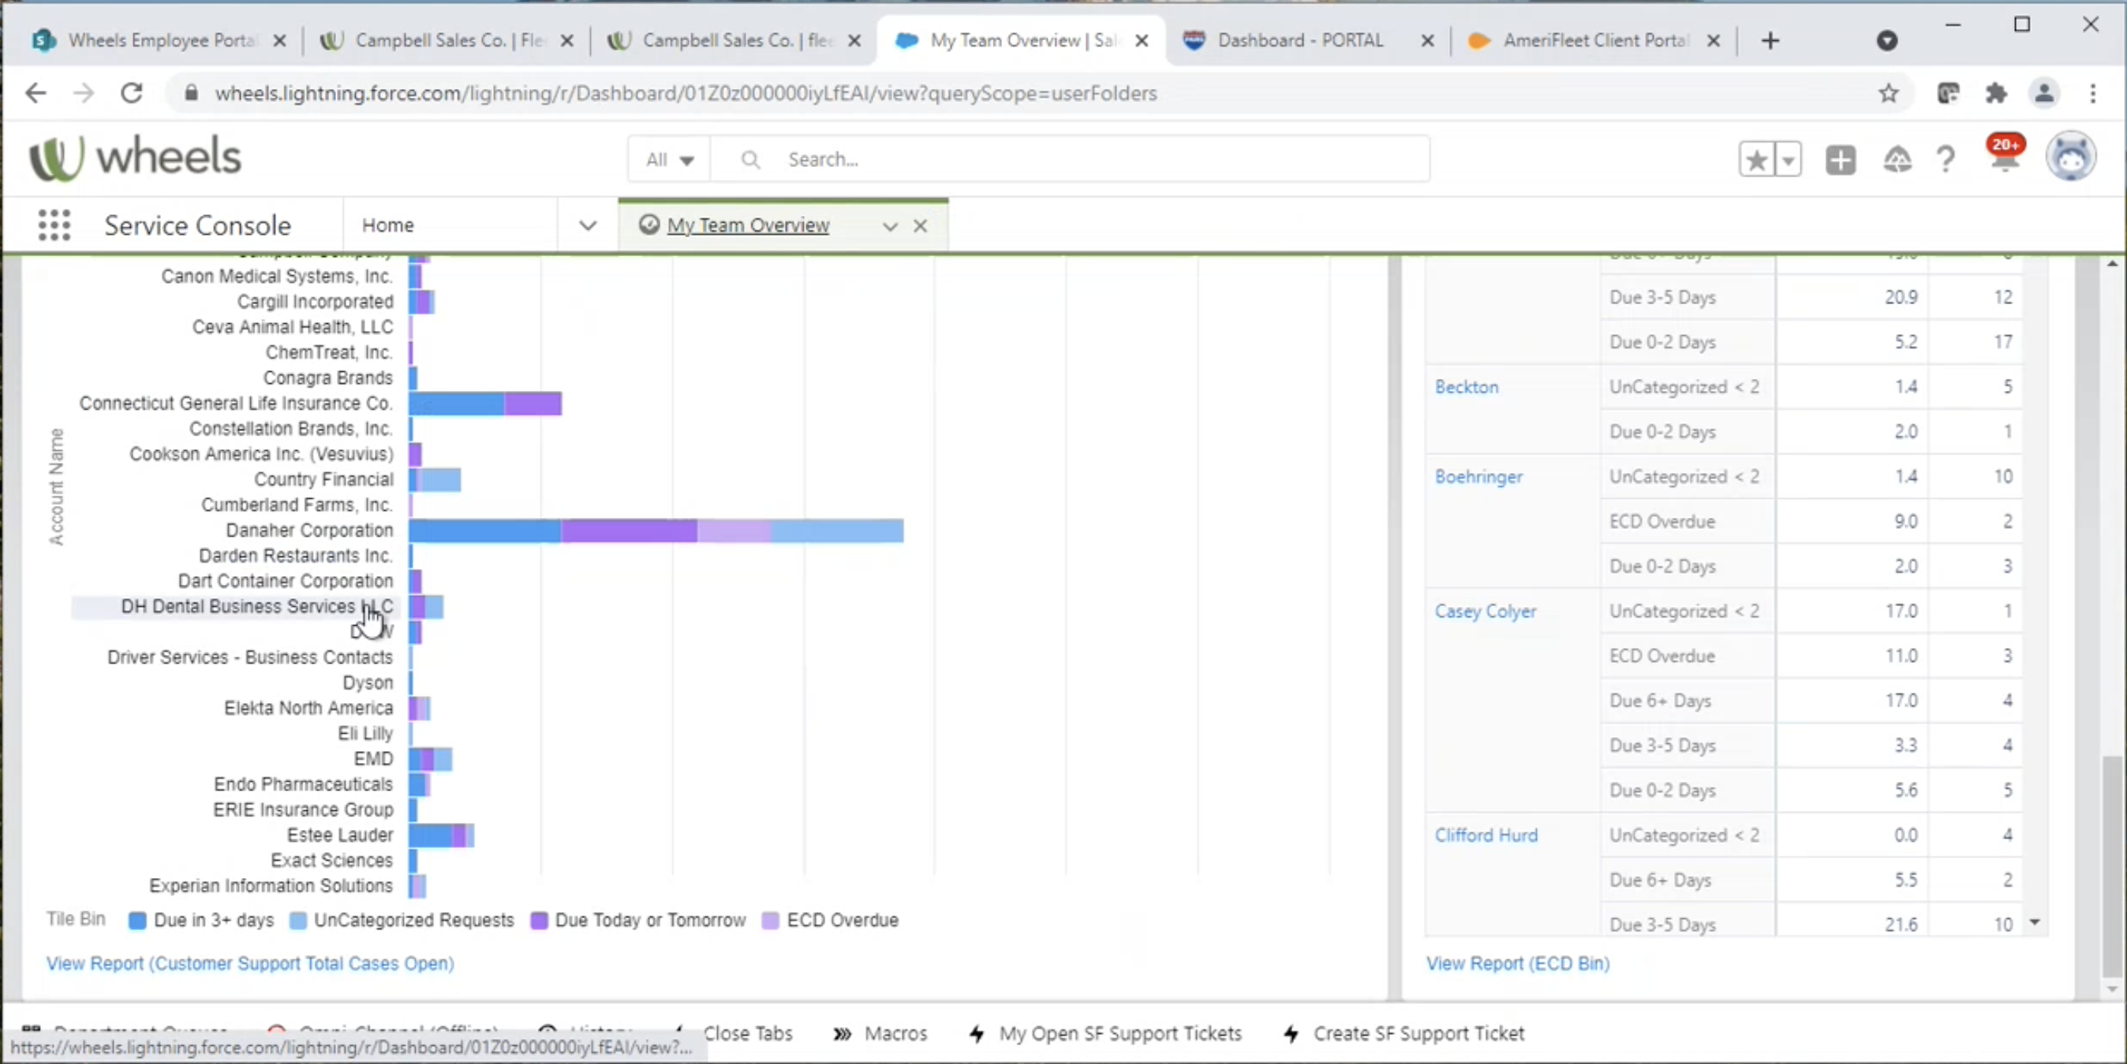
Example of My Team Overview II

Slide 27
Findings: Processes and Tools

Slide 28
Findings Summary: Processes and Tools
Processes and tools tend to reinforce one another within work environments.
Processes describe specific steps to follow, tools dictate how steps are performed due to their design.
Tools may change if they make it difficult for users to follow a process, meaning steps for use change, which may provide disruptions to task performance.
Processes tend to follow the same general steps across clients, though some clients might have specific tweaks to a process based on their fleet’s needs.
Training, documentation, and experience helps AEs learn these unique processes.
Wheels applications present a major opportunity for improvement as they often contributed to observed inefficiencies in task performance for AEs.
Lack of collocated information and no integration between tools.
Dated technology.
Inefficient and inconsistent interactions.

Slide 29
Findings Summary: Processes and Tools
Lack of collocated information forces movement between applications so that users can copy and paste information to complete tasks.
Integration between tools would reduce some of this, but this does not exist currently.
Movement between applications can be physically cumbersome given that some AEs work on three screens.
Inefficient interactions seem to be an issue for many of the Wheels apps in the study.
Numbers of clicks to access information being the most observed issue.
Inefficient interactions add time onto tasks.
Participants pointed out FleetView has inconsistent interactions around client selection.
AEs pointed out they can use some tools without being locked into a specific client, because the tool lets them swap clients. However, other tools require a client be selected before use.

Slide 30
Using Multiple Applications [4m 17s]

Slide 31
Findings Summary
Application performance also impacts task performance.
Example: DART reports can take up to 15 minutes to generate.
AEs engage in task switching while they wait for reports to finish, creating accidental opportunities where tasks take longer to complete if they forget about the report.

Slide 32
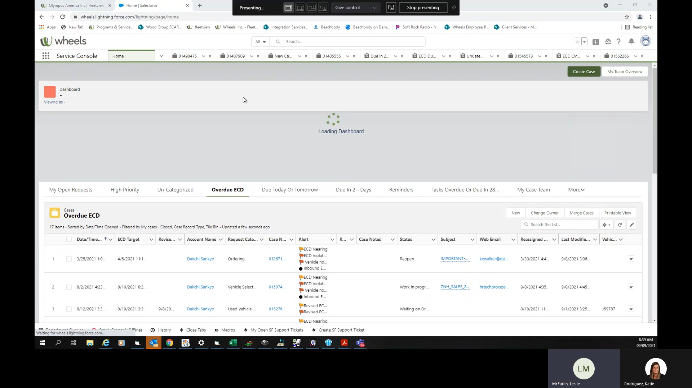
Performance: SalesForce Dashboard [Length: 34s]

Slide 33
Tools Identified During Sessions
Wheels Applications
Other Applications
FleetView (used by all participants)
CSD (used by all participants)
PARS
TRAX
Outlook
Word
Excel
Teams
SalesForce
Lotus Notes
Acertus
Smart sheets
Call Management Application
Websites related to VIN searches, vehicle features

Slide 34
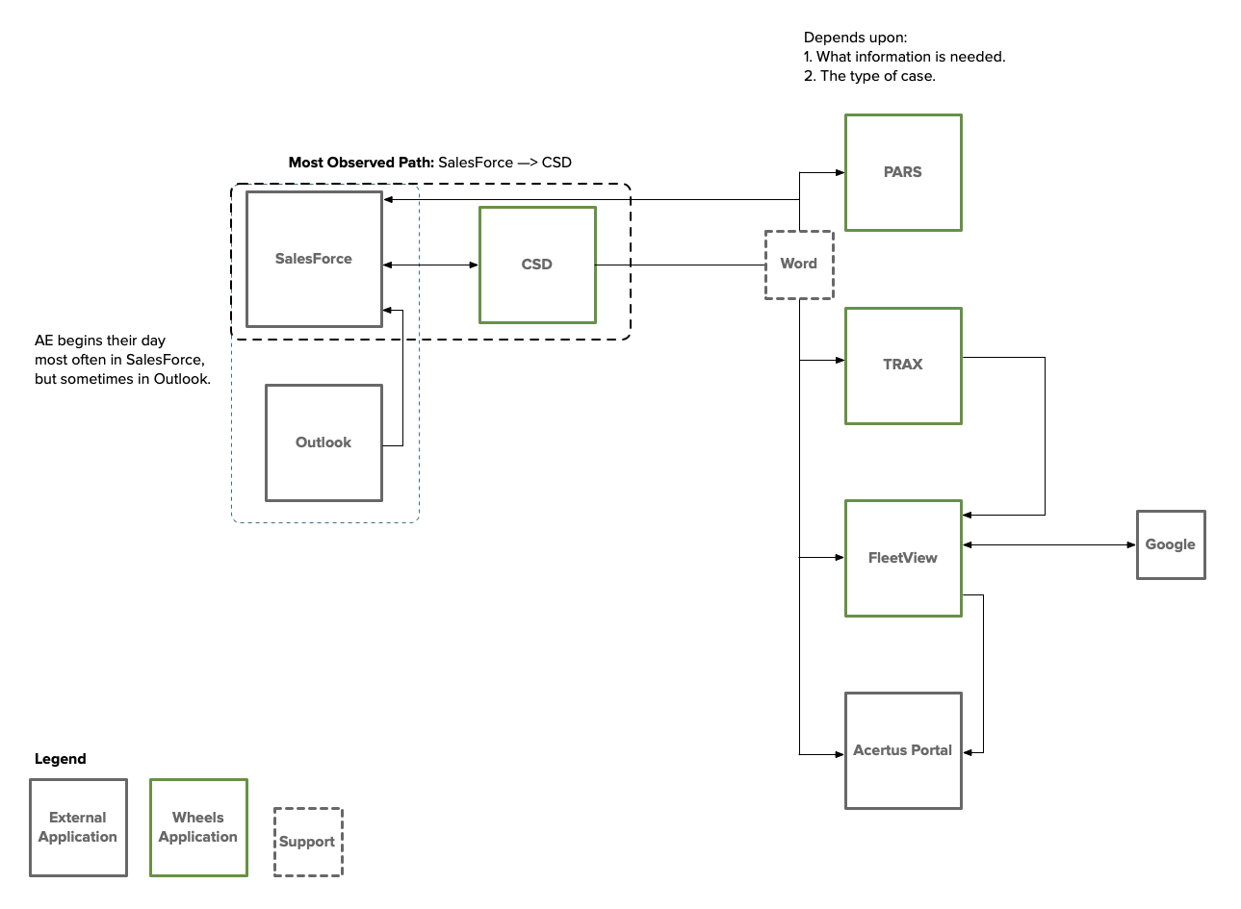
High Level Tool Usage Flow

Slide 35
Each Tool Offers Something AEs Like
FleetView presents a polished ‘prettier’ view than older applications.
All participants rated FleetView along the dimensions of helpfulness, quality of information, and ease of use.
Helpfulness ratings ranged from 3 (somewhat helpful) to 5 (very helpful).
Quality of information ratings ranged from 3 (neither high nor low quality) to 5 (very high quality).
Ease of Use ratings ranged from 4 (easy) to 5 (very easy).
CSD contains a messages field that AEs find useful.
Some AEs think finding information in CSD is more straightforward than finding information in FleetView, due to not having to select a client first.
All participants rated CSD along the dimensions of helpfulness, quality of information, and ease of use.
Helpfulness ratings ranged from 3 (somewhat helpful) to 5 (very helpful).
Quality of information ratings ranged from 3 (neither high nor low quality) to 5 (very high quality).
Ease of use ratings ranged from 3 (neither easy nor difficult) to 5 (very easy).

Slide 36
Each Tool Offers Something AEs Like
TRAX is very helpful for the registration details it provides.
One participant rated TRAX for helpfulness, quality of information, and ease of use.
For each dimension, TRAX received a 5.
Three participants rated PARS for helpfulness, quality of information, and ease of use.
Helpfulness ratings ranged from
Quality of information ratings ranged from
Ease of use ratings ranged from
SalesForce offers multiple features that help AEs:
It automatically receives emails and create cases from them.
AEs can track their progress and their teams’ progress.
AEs can view client activity.

Slide 37
Opportunities for Better AE Support from SalesForce
Emails that become SalesForce cases do not always get assigned to the correct AE.
If the case does not get assigned to the AE, then they don’t get credit for it even if they work on it.
SalesForce still require AEs to manually categorize cases.
Request categorization impacts ECD, so AEs try to pick categories that give reasonable ECDs.
SalesForce will re-open closed cases if a ‘thank you’ email is sent.
As of 2 Oct, AEs appear to have an option to control automatic case creation.
‘Search for Vehicles’ section lacks a Plate Number search field.
AEs search in a different application, such as CSD, when dealing with this information.
Large dropdowns could be improved by including type ahead functionality.
Example: Request Category

Slide 38
AEs Receive Requests from Clients via Teams
Only one participant indicated receiving requests from clients via Teams, and only from those clients who elected to use Teams.
Unlike email, requests that come in via Teams do not go directly into SalesForce.
AE spends the time entering the details into SalesForce as needed.

Slide 39
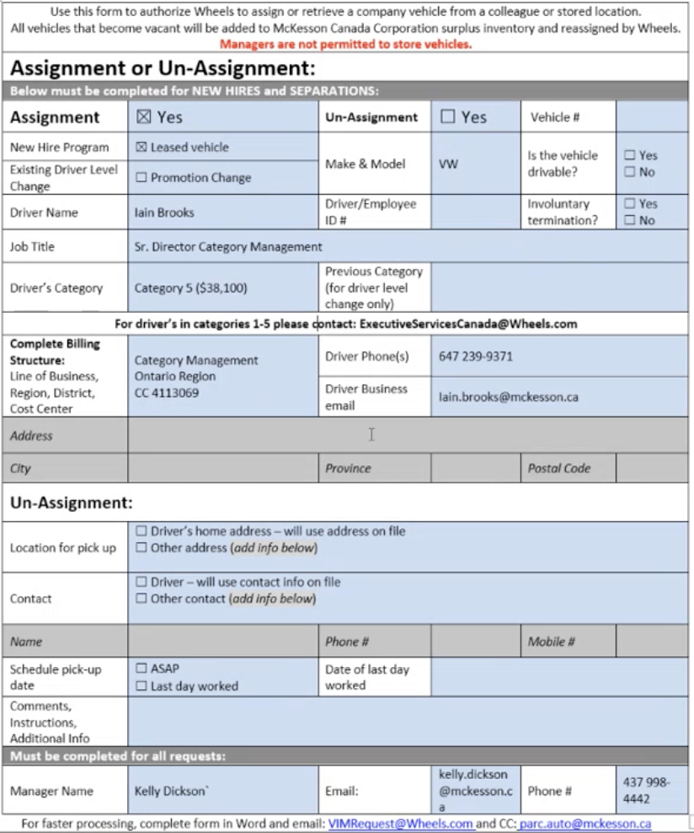
Clients Must Complete Non-Digital Forms for VIM Requests
Some clients (example: McKesson Canada) must complete forms within Word documents.
VIM associates claim the form makes it easier for them to assist the client.
Ongoing issues around form completeness exist, impacting speed of processing.
Layout and lack of visual cues make this form difficult for clients to complete.
An AE raised this issue in the past, but it seems nothing has been done to address it.

Slide 40
Work Environment

Slide 41
Findings Summary
Work environments encompass physical surroundings, coworkers, tools, and tasks.
Perceptions of work environment stability impact stress levels, optimism, resilience, and engagement.
Despite managing their cognitive workload and being well-trained on the tools they need, AEs perceive their workday as ever-changing due to client demands.
Within their teams, AEs support one another very well.
AEs indicated feeling supported by their team and leadership, though sometimes mixed messages about KPIs were received.
KPIs have links to underlying behaviors (KPIs are either achieved via actions), so there should be a focus on encouraging positive behaviors underlying KPIs.
Relying solely on KPIs to judge and reward people creates emotional responses that drive behavior (reactions, instead of proactivity).

Slide 42
Findings Summary
Workloads take over free time.
Lunchbreaks disappear when workloads increase.
AEs work during their evenings.
Some AEs work on the weekends to keep up with work (they do not interact with clients on weekends).
Experienced AEs will do things themselves as opposed to relying upon newer AEs to do it.
Some of it is skepticism over the quality of work done by newer AEs, some of it is not wanting to wait for a newer AE to do it, and some of it is knowing how to access information based on previous positions held at Wheels.
This obviously increases the workload of experienced AEs.

Slide 43
Communication Quality between Teams Impacts AEs
Input in SalesForce cases from other teams sometimes lacks enough detail for an AE to know what has been done and what remains to be done.
AEs indicated this has more to do with a lack of available time for the other teams and less with training.
Some teams seem to avoid handling cases after certain points, even dropping communication with an AE.
Example: An AE spent most of an observation session working on a request that had been open for 22 days despite it being a VIM request.
For this request, the AE reached out multiple times to the VIM associate.
Eventually, the AE made a call to resolve the issue for the client herself as it had been escalated to a manager.

Slide 44
Teams View AEs as Responsible for Client Outreach
Perceived division of work between teams often shifts burden of client communication onto AEs.
Example: Registrations force a lot of back and forth internally between AEs and registration team members, as well as between the driver and AEs in some circumstances.
AEs feel like this attitude from other teams adds to their already heavy workload.
"Uhm registration this is probably one of the biggest things and the biggest pain points. This is 'cause it's not a simple fix, right? Where other requests from fuel I want a new fuel card, right? That's a simple request. Go to fuel, submit it and it's done. Uh, registration's a little bit more hands on 'cause there's different requirements depending on that, and it's...it's just yeah, and so I think the biggest pain point for that goes is. It goes from from the driver. Say the driver called in hey, where's my registration? OK, so it goes to me. I go back to registration and say hey they need these requirements in order to complete the registration renewal, then I go back to the driver, driver goes back to me. It's...it's lot of...a lot of back and forth, where why isn't just registration taking ownership of it and going directly to to that person?"

Slide 45
Recommendations

Slide 46
Key Recommendations
Fleet Action Center presents an opportunity to shift to a proactive style of fleet management; however, AEs need a work environment that provides them the cognitive space, tools, and data to enable strategic thinking.
Reduce cognitive workload by identifying and eliminating tasks that can be automated or assigned to other groups.
Further reduce cognitive workload by consolidating information across UIs and eliminating inconsistencies and other usability issues within remaining UIs.
Focus on encouraging positive proactive behaviors to drive KPIs.

Slide 47
Restructure Information Access to Improve Efficiency
Forcing users to jump between multiple applications has two primary negative impacts to the user experience.
Increases number of clicks to complete tasks.
Forces an increase on short term memory load, which risks erroneous carry over of information, or introduction of another tool to use as a notepad for retrieved information.
"When I'm like, you know, trying to to bounce back from system to system then find out like where the registration went and what happened. So yeah to have like a simple click in fleet view where it would open up a blank word doc to just note stuff down and keep track of your thoughts while you're researching something would be helpful."
Centralize vehicle and driver data as much as possible into one application.
Consider eliminating the need for employees to select a client fleet before looking for drivers or vehicles.

Slide 48
Eliminate Usability Issues within FleetView
Inconsistent interactions impact a tool’s learnability and increase the time it takes for a user to become autonomous and efficient in the tasks requiring it.
If users must select a client before using a tool or performing a task, then make when a user performs the selection consistent across all instances.
Previous research and expert evaluations by the UX team have found inconsistent interactions within the various sections of FleetView, so a plan should be created to address those identified inconsistencies.

Slide 49
Continue Performance Improvements and Upgrades
Performance issues appear in multiple Wheels applications and have multiple negative impacts on the user experience.
Increased time on task as users wait for screens to populate.
Exceptionally long waits lead to users disengaging from a task entirely and directing their focus elsewhere.
Upgrading older reports (DART reports) will eliminate situations in which people must wait substantial amounts of time before continuing with a task.

Slide 50
Continue Identifying Opportunities for Process Improvements
Some AE work already receives support from automation, such as SalesForce automatically creating cases and filling out some details from email. This is a great start and should be expanded upon.
Consider tasks like document identification, information requests, document uploads/attachments, data entry.
RPA + Intelligent capture systems reduce repetitive tasks, speed up processes overall, and eliminate chances of human error.
Where possible, reduce the amount of 'back and forth' between AEs and other client service teams, such as Registration.
AEs wait on details from separate teams before being prepared to contact a client, adding more time onto the resolution of cases.
Relates somewhat to the recommendation of clarify boundaries around activities.
Digitize all forms clients must complete.
Non-digital forms require extra work from an employee to parse and transfer data as needed.
Clients make errors on non-digital forms due to design issues, that then delay processing and case completion.

Slide 51
Clarify Boundaries around Activities
Multiple AEs mentioned instances where they expected other teams to perform certain activities, such as making phone calls to clients; however, those other teams refuse to do those activities.
Not only does this increase AE workload, but it may also lead to frustration if it seems like the other team is deliberately ignoring work.
When this impacts case closures, clients escalate issues to managers, which unfairly puts stress on the AE.
Determine if AEs (along with FCMs) solely own client communication, or if for the sake of expediency other teams may contact clients.
Whatever decision is made, clearly communicate this and document it.
If other teams are allowed to call clients, then ensure they have call scripts to assist with the task.
Additionally, consider if certain contact reasons can be automated via direct messaging, such as emails or texts.

Slide 52
Appendix

Slide 53
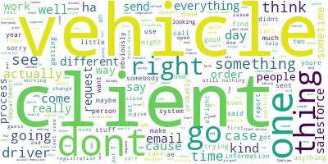
Common Conversation Topics

Slide 54
Common Conversation Topics
‘Client’ or ‘clients’ was mentioned 368 times in conversation. The top contexts in which it appeared included:
Client structure
Client services
Particular/specific client
Client wants
‘Vehicle’ or ‘vehicles’ was mentioned 357 times in conversation. The top contexts in which it appeared included:
Vehicle builder
Electric vehicles
Vehicle number
Search vehicle
Vehicle assigned

Slide 55
Common Conversation Topics
‘Driver’ or ‘drivers’ was mentioned 223 times in conversation. The top contexts in which it appeared included:
Driver tax compliance
Contacting drivers
New drivers
Driver information

Slide 56
Ratings of Wheels Applications
Participants rated their most frequently used Wheels applications on 3 scales:
Helpfulness
Quality of information
Ease of use
1 | 2 | 3 | 4 | 5
Not at all helpful | Not so helpful | Somewhat helpful | Very helpful | Extremely helpful
1 | 2 | 3 | 4 | 5
Very low quality | Low quality | Neither high nor low quality | High quality | Very high quality
1 | 2 | 3 | 4 | 5
Very difficult | Difficult | Neither easy nor difficult | Easy | Very easy

Slide 57
FleetView Ratings
FleetView was 1 of 2 applications used and rated by all study participants.
“ There’s some things that obviously…There’s so many different sections you have to go into to get something, you know…”
“OK, so a lot of the times when I'm searching up a vehicle number or something in FleetView I have to enter it like I have to enter a specific client name and search up the vehicle number which is fine, right? But in CSD you can search up any vehicle number you can search up any plate number and in one or those sorts of certain last name or something, but you don't have to enter that client code or the client number. The thing is, a lot of the times I might be given violations or like toll invoices or something with a plate number or anything like that.”
"You know what? Actually? It's a five. That's... it is really a user-friendly system."

Slide 58
CSD Ratings
CSD was the second of 2 applications used and rated by all study participants.
“That you can't usually get all of the answers from there. You have to go into another system to try and find a…you know to do things with fuel cards or to find registration information. You gotta bounce out to another system so it's not. It doesn't encompass really all the information you need. It's a handy, helpful tool, but it doesn’t... If you want details, it's not the place to find it.”
“Uhm, related to how accurately or how much information individuals are putting in there again I'm...I'm kind of relating specifically to the message file some people use that extensively. Some people don't use it at all.”
“Oh like say for example if I'm like looking at an image in in CSD, a lot of the times I don't know why this happens, that if it's specific with me, but I know what happens with other AEs like I try to open up an image and sometimes it works, but other times it just makes CSD into a tiny little square where you can barely see anything.”

Slide 59
Other Application Ratings
Three participants provided ratings for TRAX
One participant rated PARS, and indicate a rating of 5 on each scale:
5, Very Helpful
5, Very High Quality
5, Very Easy

Slide 60

Thank you!

